Slide 1

Project Presentation
On
Complete Healthcare Solutions using Harris Benedict equations on Basal metabolic rates(BMR)
Project Guide : Prof. Mrs Vandana salve
Team Members:
Department of Computer Engineering
Mahatma Gandhi Mission’s College of Engineering & Technology
Kamothe, Navi Mumbai – 400 209
University of Mumbai
Academic Year : 2021-2022
Bhagyashri Sunil Chaudhari | 118CP1293B
Sakshi Jagdish Bole | 118CP1321B

Slide 2
ABSTRACT
This project deals with Complete Healthcare Solution web application framework and responsive web design which work on desktop, MAC and mobile devices.
This application aim at providing fitness and healthcare precautions and tips along with providing solutions to the users.Also keep the user updated about mental health through questionnaire survey tests related to anxiety , depression and fitness.
It is a very responsive web application saving peoples money and time by cutting their frequent visits to the doctors for regular check ups & healthcare,fitness updates.

Slide 3
INTRODUCTION
Nowadays healthcare and fitness has become a very common social issue which need to be taken into light especially after the COVID pandemic situation.
To solve this issue we came with a service provider client user interaction website ‘Complete Healthcare Solution' which will work as a guide for user whenever they need help related to health and fitness from tracking their common health to taking advice from expertise.
It has features like fitness calculators ike BMI,calorie meter,BP tracker etc. In addition to this application also provide health tips about exercise routine,mental health,yoga,meditation,nutrition,pre and post covid tips and women health issues.
We provide a platform to user where they can contact us anytime from anywhere through mails, online chat and paid video call consultation with our health expertise.
Beside this,application has feature of maintaining the past,present & future records,reports of the users fitness and health.

Slide 4
LITERATURE SURVEY
S.no | Authors | Year of Publication | Title | Concept | Description | Disadvantages
1 | Rohan V. Vaidya,Darshan K. Trivedi | IEEE 2017 International Conference on Computing Methodologies and Communication (ICCMC) | M-Health | smart android base web application using firebase,php,MySql,HTML ,Firebase Cloud Messaging etc. | Track the fitness ,Schedule offline appointments with Doctor ,Set reminder for medicines and Can request blood from a nearby donor | provide no solution for mental health issues,unableto provide chats and video call feature.Only works on android device only.
2 | Sofia Evaristo, Carla Moreira, Luís Lopes, Andre Oliveira, Sandra Abreu , Cesar Agostinis-Sobrinho , , Jose Oliveira-Santos , Susana Povoas | Journal of Exercise Science & Fitness (2019) | Muscular fitness and cardiorespi-ratory fitness | concept of cardiorespiratory and fitness with balanced quality of lifestyle includes diet,nutrients etc. | Muscular fitness and cardiorespiratory fitness associated with health-related quality of life. | only related to muscular and cardiorespiratory issues & not others like mental illness,obesity etc.

Slide 5
S.No | Authors | Year of Publication | Title/ study | concept | Description | Disadvantage
3 | P.Ajitha | International Journal of Research in Engineering and Science (IJRES)-2020-21 | Responsive Design in Web Development with Security Using Optimization Algorithms | MD5, Web development; Responsive design; Web designing; User experience ,Hash Function, Security Standards. | paper analyses the security risks of the hashing algorithm MD5 in password storage to enhance security storage and different solutions, such as salts and iterative hashing. | websites are prone to security attacks,hence nowadays every web application needs its app version for more secure and easy access.
4 | Megha Saloni(Dept. of Information Technology), Dayanand(Dept. of Computer Science Engineering) | International Journal of Engineering Research & Technology (IJERT)-2018 | Security Issues in E-Commerce | security issues like DDos,Dos etc.Prevention using firewall,encryption VPNs etc. | loopholes of E-commerce and any business to consumer issues and preventive strategies | Instead of having various strategies there is always a hack to destroy any type of security.

Slide 6
OBJECTIVES
Main aim is to make a user friendly responsive healthcare & fitness web application.
It helps the users to stay updated about their physical & mental health with the help of some fitness calculators, questionnaire quiz & latest , updated tips.
Prevention is better than cure , hence it provides platform for users to interact with fitness and healthcare expertise for further advices.
The users can operate the application from anywhere at anytime & it helps in preventing their frequent visits to doctor for small check ups or issues saving time & money.

Slide 7
METHODOLOGY
EXISTING SYSTEM | PROPOSED SYSTEM
*Use of Cameron et al(2004) proposed algorithms for the main purpose of application that is for calculating basal metabolic rates. | * Use of Harris Benedict equations globally proposed by WHO for calculating Basal metabolic rates.
*Developed using android written in JAVA language, firebase for web development, php, MySQL RDBMS,HTML. | *Developed using microsoft C#,microsoft .Net core 3.1,SQL server,HTML5,Bootstrap 3,AJAX,javascript,jquery,bootstrap sweet alerts.
*use of PHP using haveshine formula for alerts. | *HTML5 for web notifications,TAWK.IO plugins for chats,microsoft 2 factor authentication.
* No such features are present. | *Third party use for zoom video calls,stripe for payment gateway, SMTP for email, calendly scheduler for taking appointments.
*Android based app. | *Dynamic web application applicable on devices like windows,MAC and mobile phones.

Slide 8
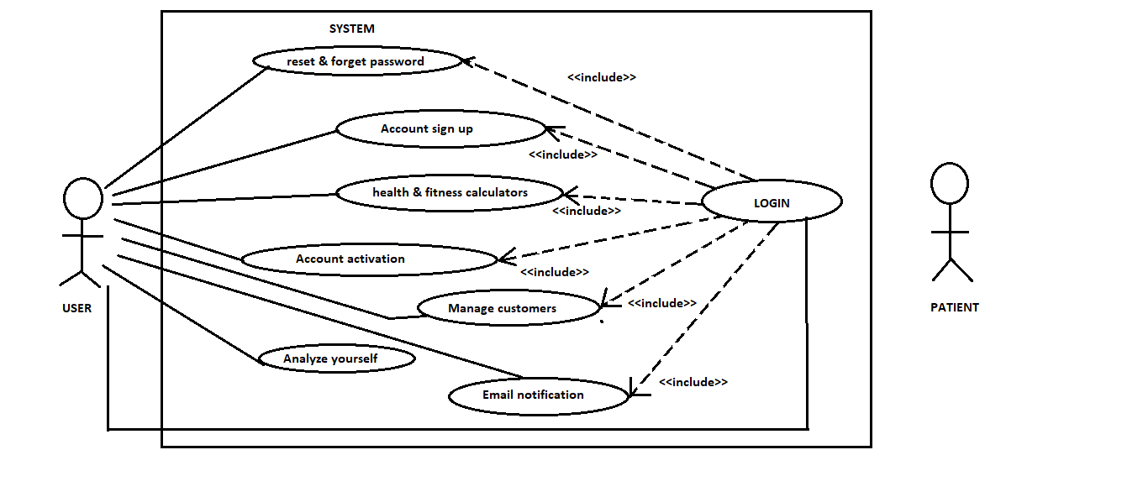
System architecture

Slide 9

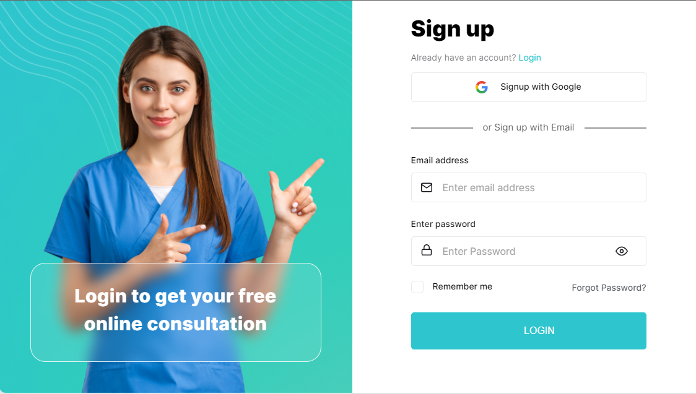
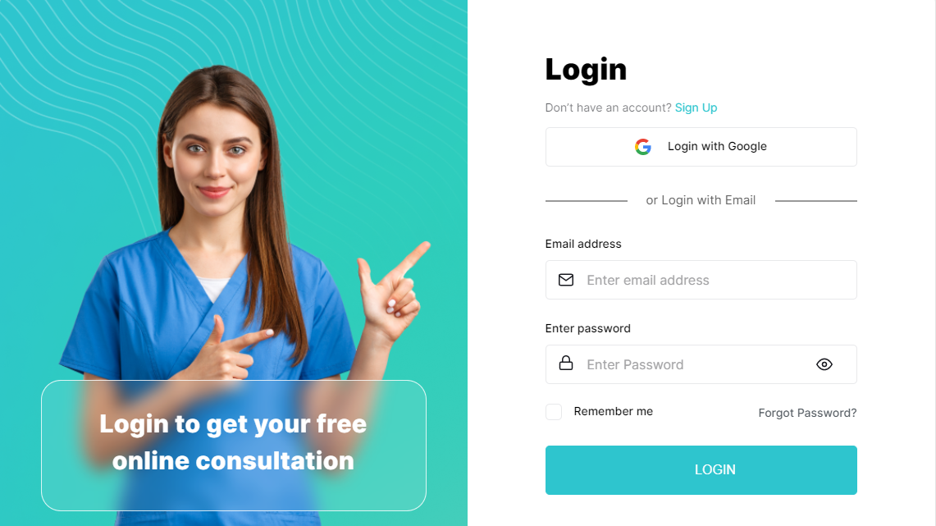
RESULTS
Home Page
Sign Up
Login

Slide 10
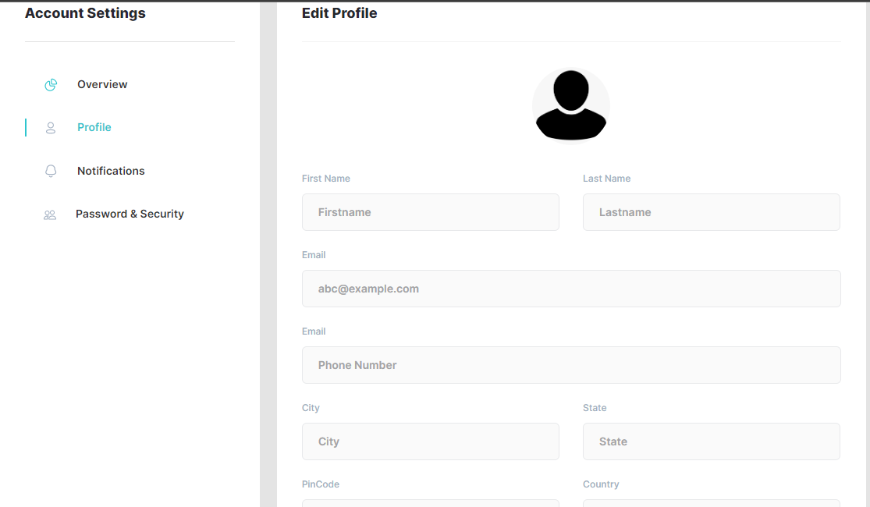
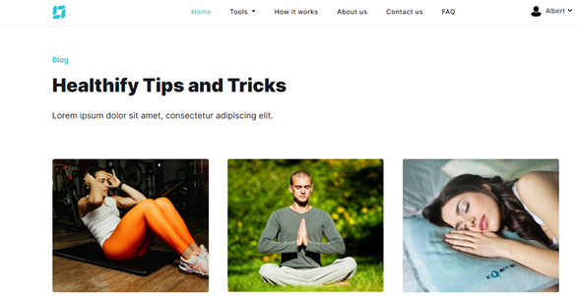
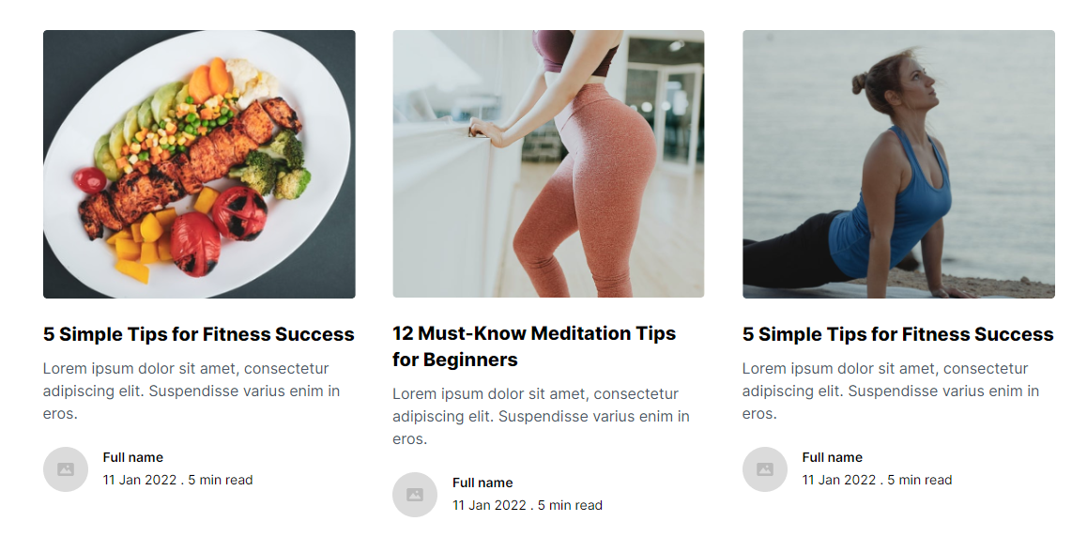
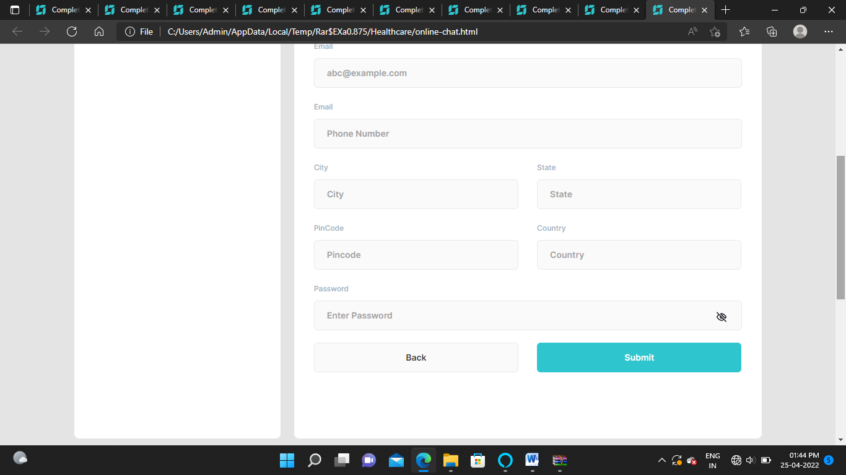
Profile Page
Blog

Slide 11
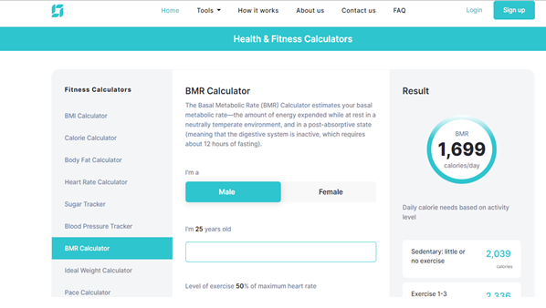
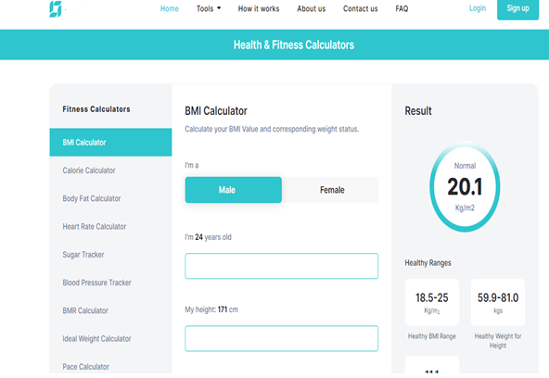
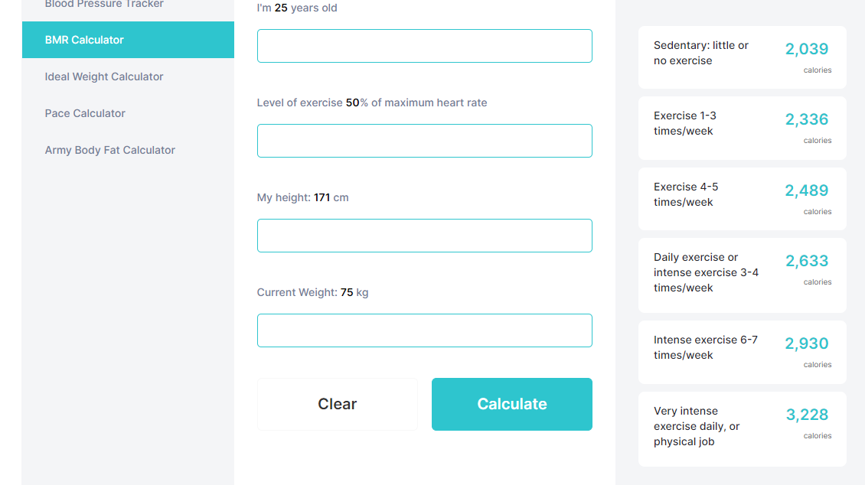
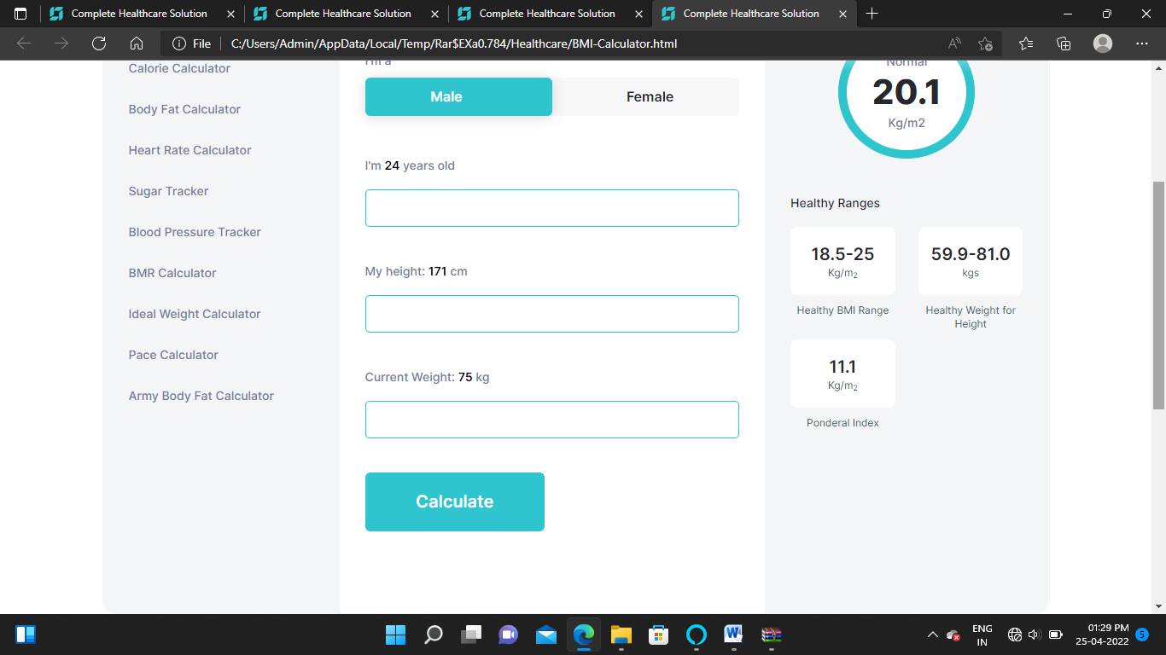
BMI Calculator
BMR Calculator

Slide 12
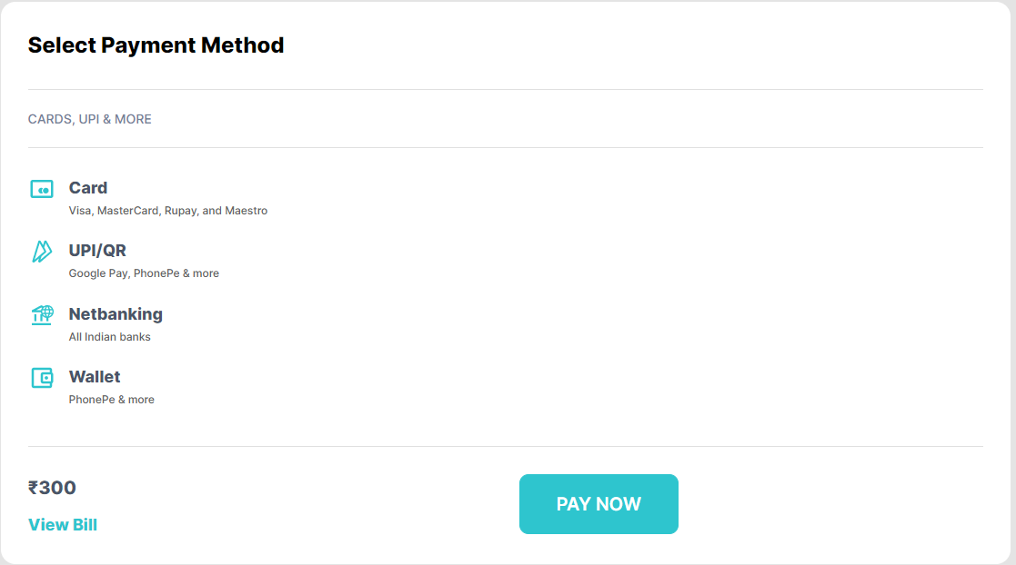
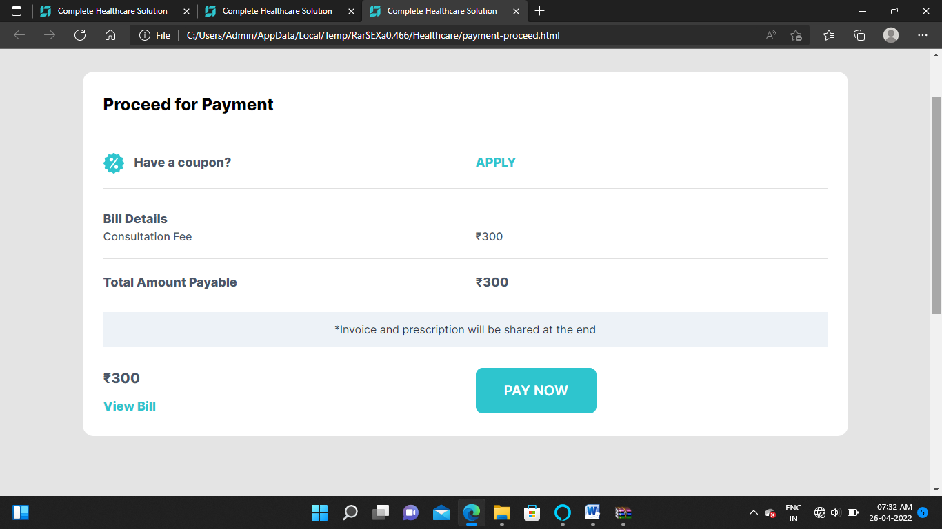
Payment Method
Payment Process

Slide 13
APPLICATION
This website will definitely save the time and money of the user,addition to this it is very user-friendly and easy to use.
It lead the people to become conscious and aware about importance of health and fitness.
It provide budget free solutions from best health & fitness expertise.
This application helps in contributing to a disease free and healthy India without taking efforts just by sitting at home.

Slide 14
FUTURE SCOPE
System will automatically send sms notification on users mobile.
Notification with alert mechanism for system.
Package based subscription method for free consultancy for as long as your package limit.
Providing platform for users so they can share their improvement & experience.
External login using various more social platform like facebook , twitter.
System can become multi-lingual.
Use of 3D authentication in Payment.

Slide 15
CONCLUSION
As per the present scenario of covid-19 pandemic maintaining health and fitness become very important . Due to this pandemic mental illness has arouse to such an extent that it results in severe depression leading to suicides.
According to WHO covid is never ending disease which will give various health problems for lifetime , this application will help to solve this social issues in people . It provide easy track of health along with its solution for user just by sitting at home.
It is a future need of country as according to IBEF(India Brand Equity Foundation) the government of India plan to spend 3% of GDP to improve healthcare by 2022.Also the healthcare sector is going to reach about 372 billion US$ by 2022 driven by increase in healthcare awareness and good lifestyle.
This web application provides all fitness and healthcare tips, rising awareness and importance in people about so by combining it with technology ,providing flexibility of time and space.

Slide 16
REFERENCES
IEEE standards,
1-Yuanyuan Du, Yu Chen, Dan Wang, Jinzhao Liu,Yongqiang Lu. ”An Android-Based Emergency Alarm and Healthcare Management System.”in 2011 IEEE International Symposium on IT in Medicine and Education
2-Fletcher Lu,Manon Lemonde. ”Reducing Adolescent Obesity with a Social Networking Mobile Fitness Application.” in 2014 IEEE 16th Inter-national Conference on e-Health Networking, Applications and Services (Healthcom)
IJRES standards
[2]. Alqahtani, A., & Goodwin, R. (2012). E-commerce smartphone application. International Journal of Advanced Computer Science and Applications, 3(8), 54-59
[3]. Berson, Thomas A. "Differential Cryptanalysis Mod 232 with Applications to MD5". EUROCRYPT. pp. 71–80. ISBN 3-540- 564136. , 1992.
[4]. Xiaoyun Wang; Hongbo Yu. "How to Break MD5 and Other Hash Functions". EUROCRYPT. ISBN 3-540-25910-4, 2005.
[5]. Baker, S. (2014). Making it work for everyone: HTML5 and CSS level 3 for responsive, accessible design on your library's web site. Journal of Library & Information Services in Distance Learning.

